Slide 1
Microcomputer Principles
&
Computer Interface
Lu Yin
luyin@nwpu.edu.cn

Slide 2
Chapter 6
Signed Numbers, Strings, and Tables
Contains
  Coding to deal signed numbers
  Sign flag extension
  Shifting of signed numbers
  Coding with string processing instructions

Slide 3
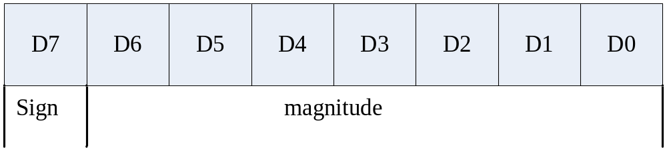
Section6.1
Signed Number Arithmetic Operations
Concept of signed numbers in computers
  Set aside the MSB for the sign (1 means negative)
Signed byte operands
  Taking byte sized operand for example, the D7(MSB) is set aside for the sign
Range of signed byte operand
  DEC: -128, …, -1, 0, +1, …, +127
  HEX: 80, …, FF, 00, 01, …, 7F

Slide 4
Section6.1
Signed Number Arithmetic Operations
Negative numbers in computer
  Negative numbers are represented in 2’s complement in computer
  3 steps to convert a negative number (byte size) to its 2’s complement:
    Write the magnitude of the number in 8-bit binary
    Invert each bit
    Add 1 to it

Slide 5
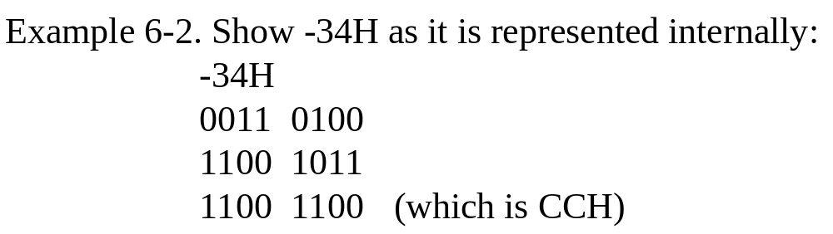
Section6.1
Signed Number Arithmetic Operations
Example of negative number in computer

Slide 6
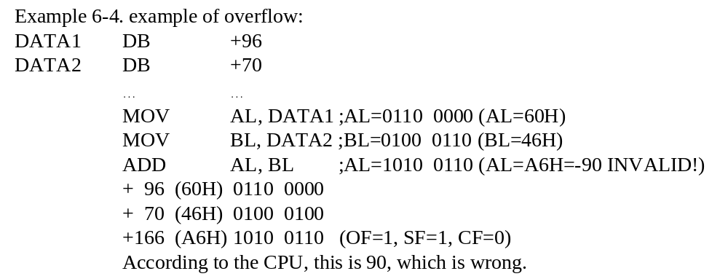
Section6.1
Signed Number Arithmetic Operations
Overflow problem in signed number operations
regard 10100110 as a 2's compliment, it equals to -5A, which is -90 in decimal.
  In the example above, the addition result in AL is A6H, which is the 2’s complement of -5AH(-90 in decimal).

Slide 7
Section6.1
Signed Number Arithmetic Operations
CPU sets up OF bit when:
  Byte size operand (see examples 6-5 6-6):
    There is a carry from D6 to D7 but no carry out of D7(CF=0)
    There is a carry from D7 out (CF=1) but no carry from D6 to D7
  Word size operand (see examples 6-8 6-9:
    There is a carry from D14 to D15 but no carry out of D15 (CF=0)
    There is a carry from D15 out (CF=1) but no carry from D14 to D15

Slide 8
Section6.1
Signed Number Arithmetic Operations
Operand sign extension
  Sign-extend the operand to avoid overflow error
  Sign extension copies the sign bit of the lower byte of a register into the upper bits of the register.
  Instructions for sign-extend: CBW, CWD
    Extend the operand (8bits->16bits, 16bits->32bits)
    Copy the sign flag to all bits in the extended bytes
    Result: keep the value of operand in 2’s complement form, while extend the size of the operand
  Detect overflow error and use CBW/CWD to avoid:
    Example 6-10, rewrite example 6-4

Slide 9
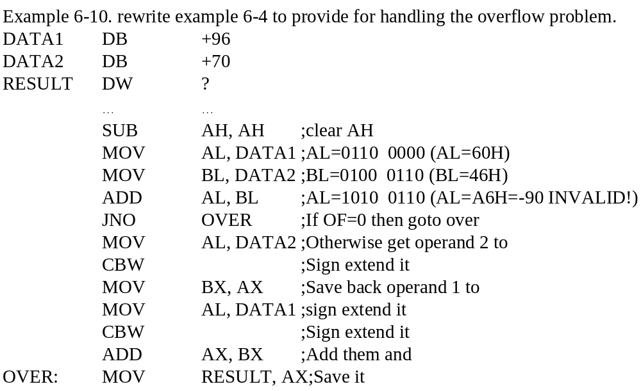
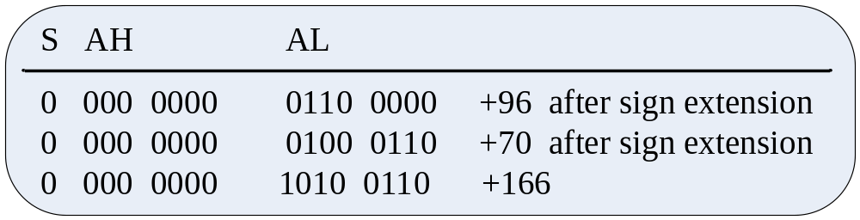
Section6.1
Signed Number Arithmetic Operations

Slide 10
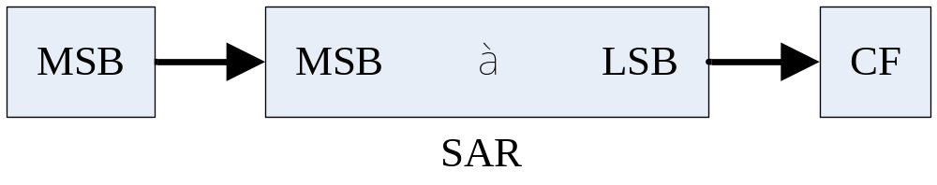
Section6.1
Signed Number Arithmetic Operations
Arithmetic shift
  SAL and SHL do exactly the same thing.
  SAR do:
    Logical shift to right
    Copy the sign bit to the shifted bits

Slide 11
Section6.1
Signed Number Arithmetic Operations
Division of signed operands
Division | Numerator | Denominator | Quotient | Rem.
Byte / Byte | AL=byte CBW | Reg/Mem | AL | AH
Word / Word | AX | Reg/Mem | AX | DX
Word / Byte | AX=word | Reg/Mem | AL¹ | AH
Doubleworld/word | DXAX=doubleword | Rem/Mem | AX² | DX
NOTES:
Divide error interrupt if -127 > AL > +127ign
Divide error interrupt if -32768> AL > +32768

Slide 12
Section6.1
Signed Number Arithmetic Operations
Multiplication of signed operands
Multiplication | Operand1 | Operand2 | Result
Byte x Byte | AL | Reg/Mem | AX¹
Word x Word | AX | Reg/Mem | DX AX²
Word x Byte | AL = byte CBW | Reg/Mem | DX AX²
NOTES:
CF=1 OF=1 if AH has part of the result; CF=0 OF=0 if AH holds the extended sign
CF=1 OF=1 if DX has part of the result; CF=0 OF=0 if DX holds the extended sign

Slide 13
Section6.1
Signed Number Arithmetic Operations
Signed number comparison
  The same with unsigned operands: CMP
    Dest > sor OF=SF or ZF=0
    Dest = sor ZF=1
    Dest < sor OF=negation of SF

Slide 14
Section6.2
String and Table Operations
How does string operand stored?
  In X86 assembly language program, Indexed Relative Addressing Mode is applied in accessing the characters within the string;
  SI holds the offset address of source string;
  DI holds the offset address of the destination string; destination string operand;
  SI use DS by default as the segment register;
  DI use ES by default as the segment register;

Slide 15
Section6.2
String and Table Operations
How to scan the string?
  In order to process operands located in consecutive memory locations, the offset address holed by SI (or DI) is modified;
  DF (the direction flag, D10 in FR) indicates inc/dec the offset address:
    DF=0, offset register ++;
    DF=1, offset register --;
  Instructions defined to manipulate DF:
    Instruction CLD: clear DF=0
    Instruction STD: set DF=1
  REP prefix
    The REP prefix allows a string instruction to perform the operation repeatedly;
    CX is used as the default repeat counter.

Slide 16
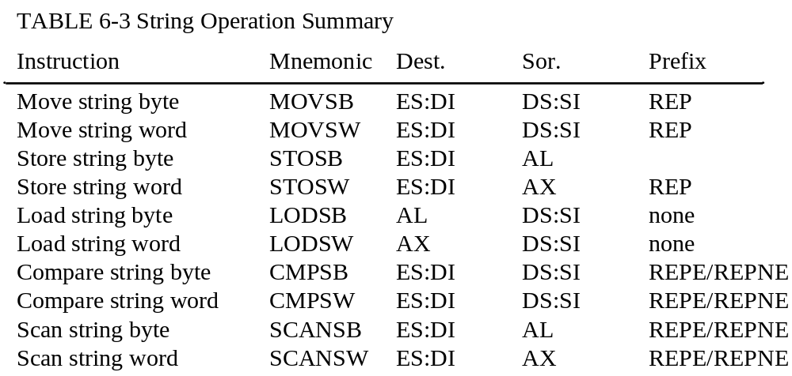
Section6.2
String and Table Operations

Slide 17
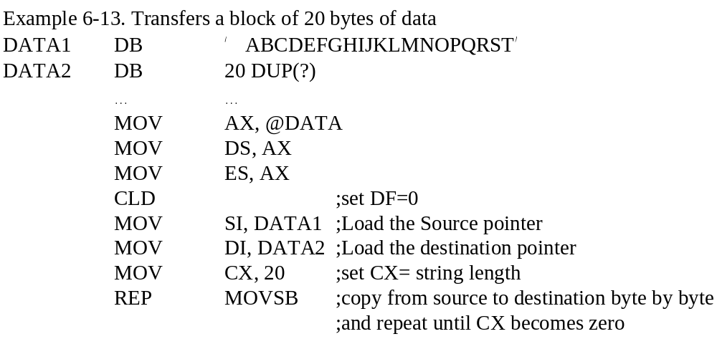
Section6.2
String and Table Operations

Slide 18
Section6.2
String and Table Operations
Instructions of write to memory and load from memory
  STOSB, STOSW
  LODSB, LODSW
Multiple conditions repeat prefixes:
  REPZ(REPE): repeat untile dest=sor (ZF=1), or cx=0
  REPNZ(REPNE):repeat untile dest!=sor(ZF=0), or cx=0

Slide 19
Section6.2
String and Table Operations
Compare two strings
  Instruction CMPSB/CMPSW, with REPE/REPNE
  Then use JE / JNE
  (see example 6-15)

Slide 20
Section6.2
String and Table Operations
Scan string: SCASB instruction
  This instruction compares each byte of the array pointed at by ES:DI with the contents of the AL register. Prefix REPE/REPNE is required.
  Conditional jump can be done, after SCASB
Replacing the scanned character
  REPNE SCASB
  JE to do replacement (see example 6-16)

Slide 21
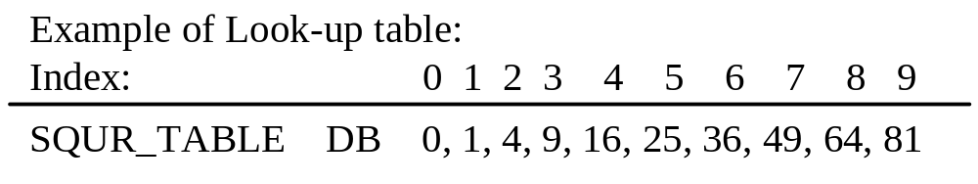
Section6.2
String and Table Operations
XLAT (translate) instruction and look-up tables
  A look-up table is a queue of data in memory space, and the date value have something related with its index.
  An example of look-up table is a square table

Slide 22
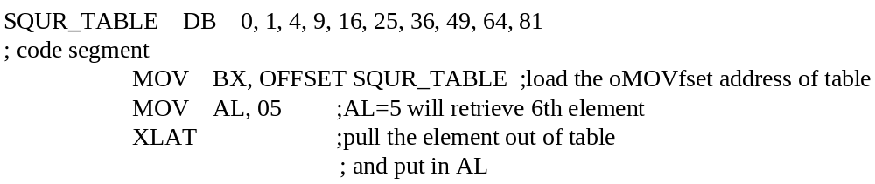
Section6.2
String and Table Operations
XLAT instruction and look-up tables
  XLAT requires BX to point to the table
  Requires AL to hold the key (table index)
  The retrieved data will be loaded into AL

Slide 23
Section6.2
String and Table Operations
In actuality, XLAT is one instruction, which is equivalent to:
  SUB AH, AH ;clear AH
  MOV SI, AX ;SI = 000X
  MOV AL, [BX+SI] ;get the SIth entry from beginning of the table

Slide 24
Section6.2
String and Table Operations
Code conversion using XLAT:
  Build up a dictionary in the form of look-up table;
  Find the relevance between the index of the characters and the ASCII numbers of the source string;
  Use XLAT to encode the source string.
How to decode it?
  Use string scan instructions.
Additional example : XLAT-encode.asm

Slide 25
Chapter 6
Exercises
  Section 1: Problem 2
  Section 2: Problem 11

